Slide 1

Overview of DHCS Quality Strategy 2022
Brendan Mull, MD
Manager, QM, MedPOINT Management

Slide 2
Background
DHCS has released its first major update of its Comprehensive Quality Strategy since 2018.
DHCS is working to harmonize its quality strategy with CalAIM and other new initiatives.
The state is under pressure from CMS, the media and advocacy groups to improve plan quality and oversight of subcontractors.
We should advocate for and exemplify high quality care.

Slide 3
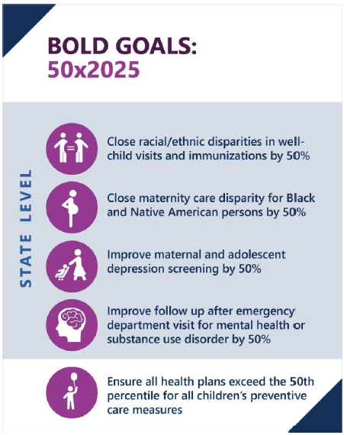
Quality Performance Priorities
Improving clinical quality and reducing racial/ethnic disparities are strong themes in the CQS.
Clinical priority areas include:
children’s preventive care
maternity care
behavioral health integration
In addition to state-level goals, DHCS has committed all health plans to exceeding the National Medicaid 50th Percentile for all children’s preventive care measures by 2025.

Slide 4
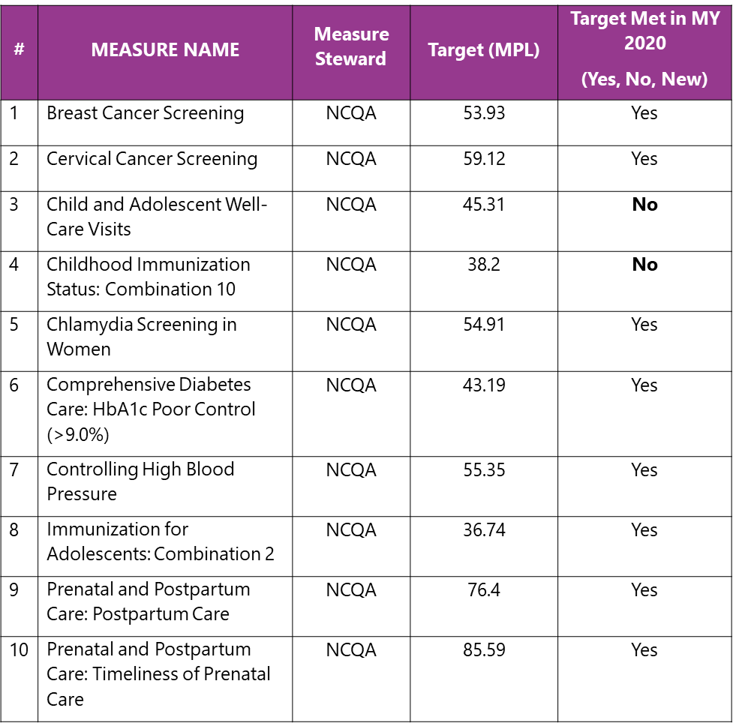
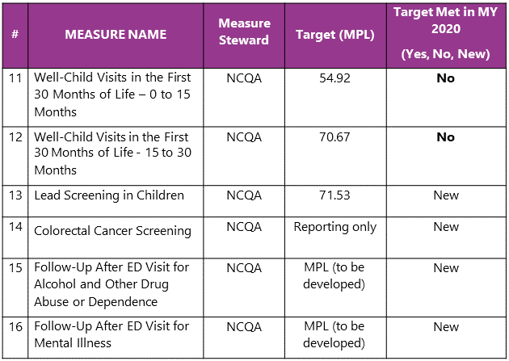
Managed Care Accountability Set
Note: “Target” = NCQA National Medicaid 50th percentile. “Target Met in MY 2020” = Was Target Met for All Medi-Cal Members Statewide in last year for which we have full data?

Slide 5
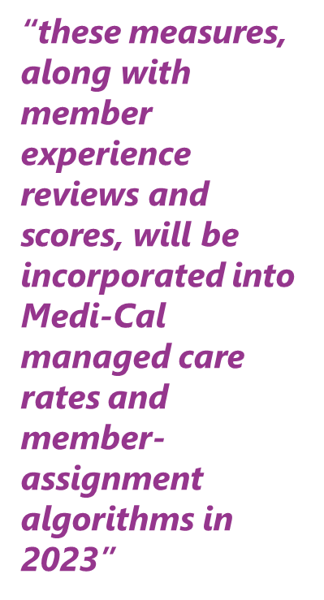
Accountability
DHCS proposed several methods to improve accountability:
Public-facing performance dashboards
Corrective action plan whenever a plan performs below the 50th percentile for any MCAS measure
Financial incentives and penalties
Enhanced auto-assignment algorithm

Slide 6
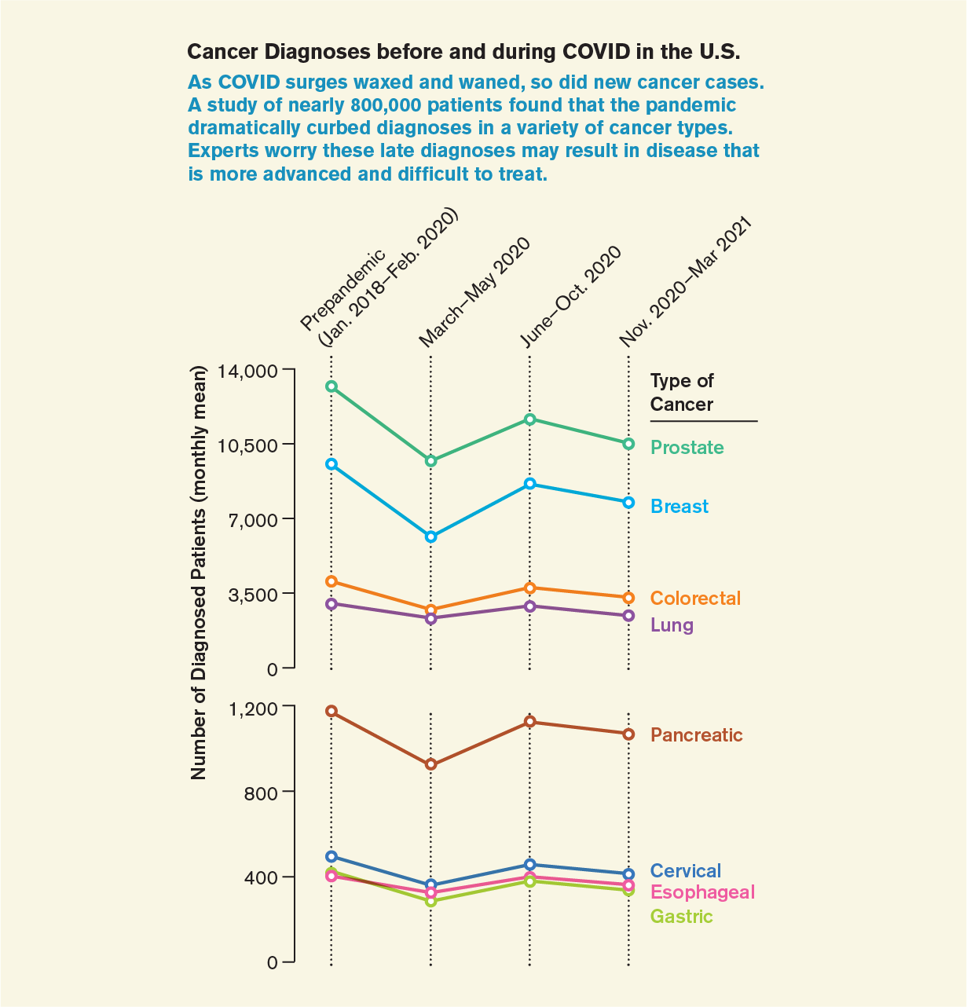
Cancer Screenings
Cancer diagnoses decreased at the onset of the pandemic and have yet to return to pre-pandemic levels.
While the long-term impact is unclear, the pandemic may have exacerbated racial/ethnic disparities in screening.
African-Americans already had 40% higher mortality from colon cancer
We need to increase screening rates for breast, cervical and colorectal cancer (and HPV immunization!)
We need your supplemental data.
Source: JAMA Network, 8/31/2021

Slide 7
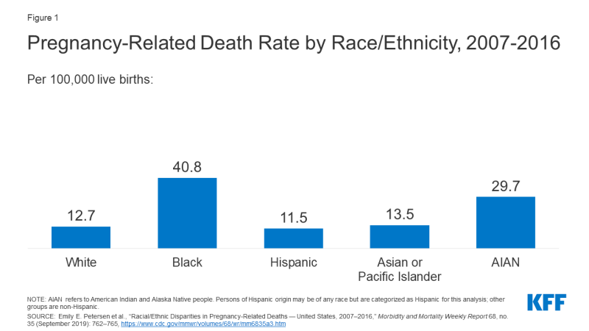
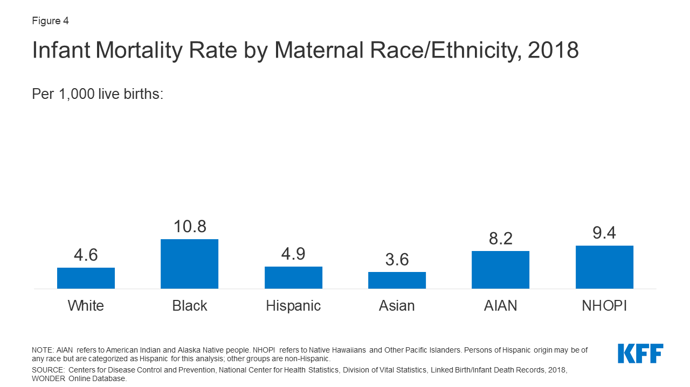
Perinatal Care
DHCS is committed to improving racial disparities in maternal and neonatal outcomes.
Care for chronic conditions is an important contributor to outcomes.
Expect more measures related to specific aspects of perinatal care in coming years
Performance on these measures has decreased somewhat during the pandemic, partly due to access and partly due to data collection issues.
Source: JAMA Network, 8/31/2021

Slide 8
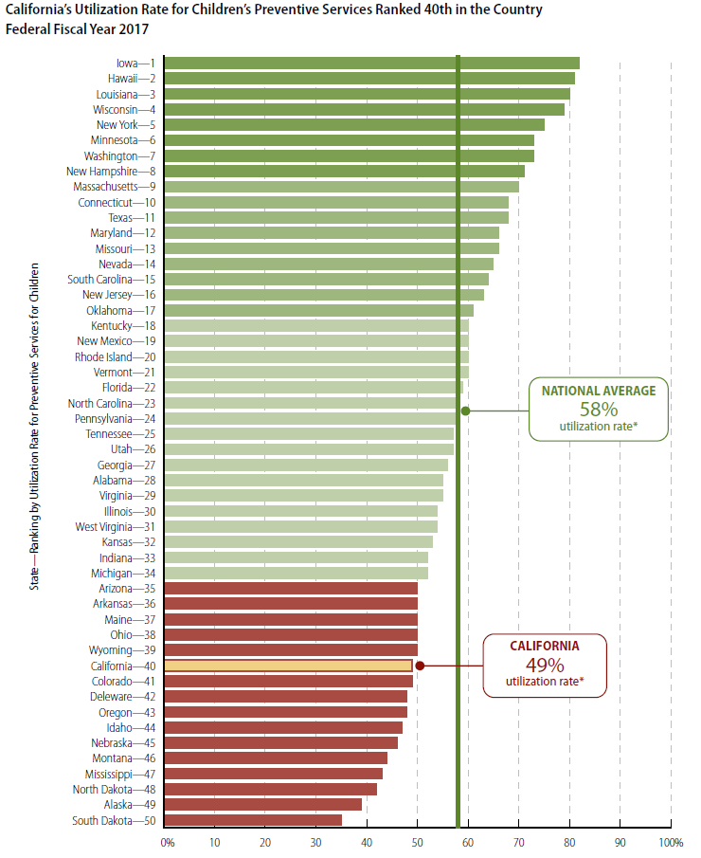
Children’s Preventive Care
Even prior to the pandemic, DHCS was concerned about low utilization of children’s preventive services.
Pediatric visits dropped by up to 40% during the pandemic and have yet to return to pre-pandemic levels.
By 2025, every health plan must have all pediatric preventive measures at or above national Medicaid 50th percentile:
Well-care visits
Immunizations
Lead screening

Slide 9
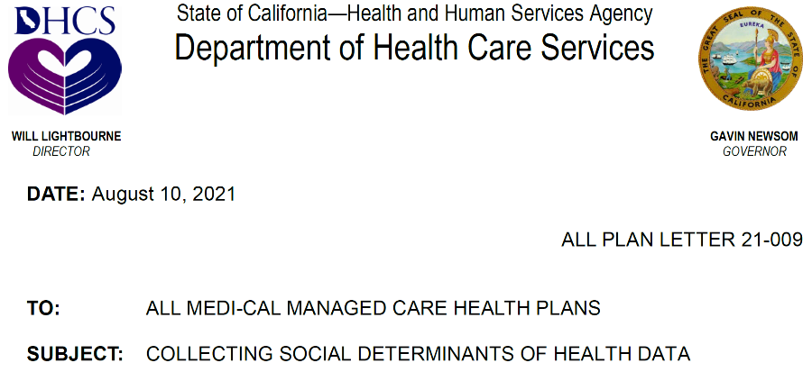
SDOH: DHCS Priority Codes
SDOH codes are ICD10 codes in the range Z55-Z65.
DHCS has identified 18 priority SDOH codes that are vital to the CalAIM Population Health Management initiative.
SDOH codes will be used by DHCS to risk stratify patients in 2023.
If you have not done so already, please implement SDOH codes now.

